Slide 1

Data Stream
Thuc Le
Advanced Analytic Techniques 2
University of South Australia

Slide 2

Outline
Classification with data streams
Clustering with data streams

Slide 3

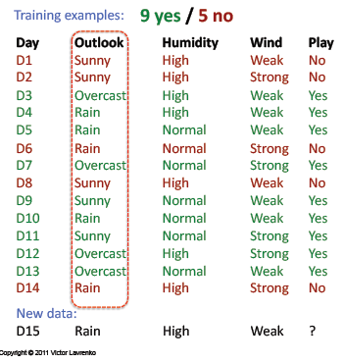
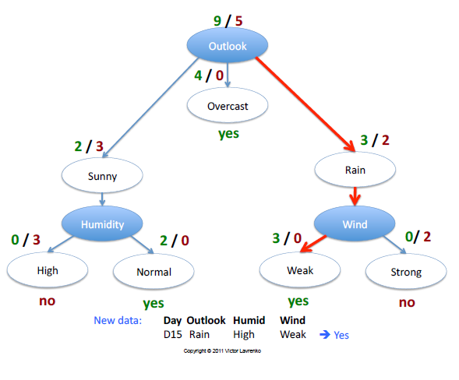
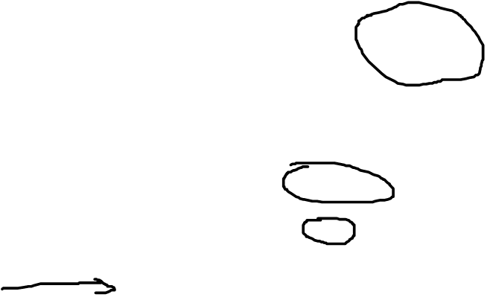
Decision tree

Slide 4

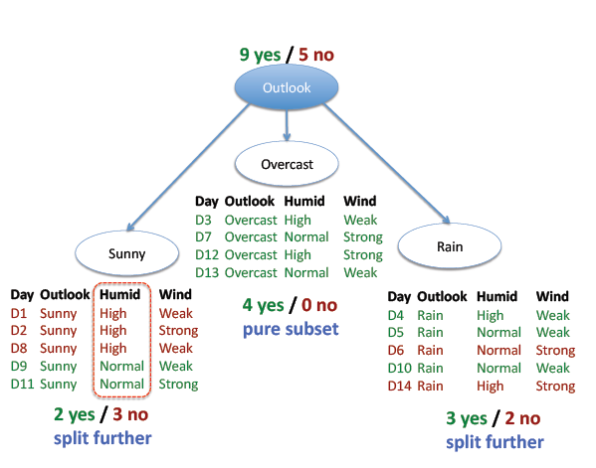
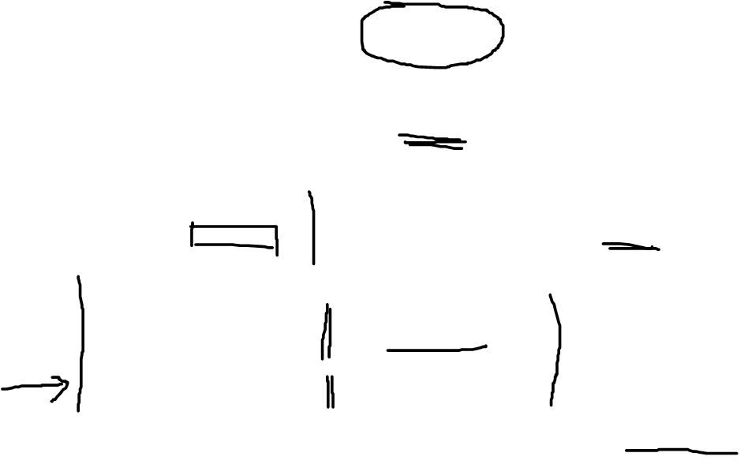
Decision tree

Slide 5

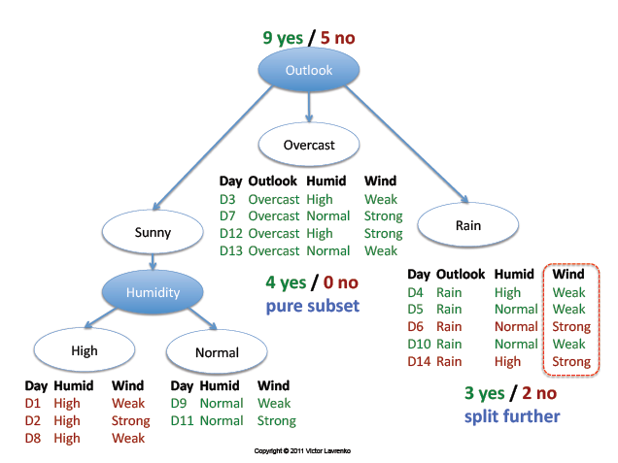
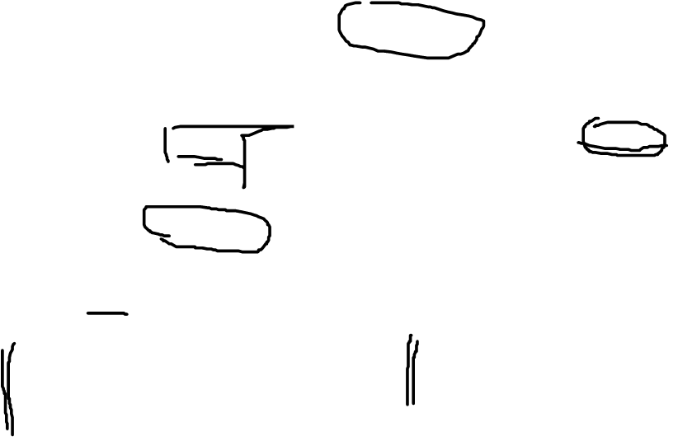
Decision tree

Slide 6

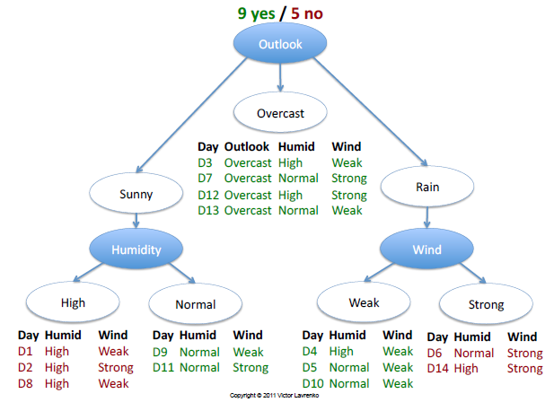
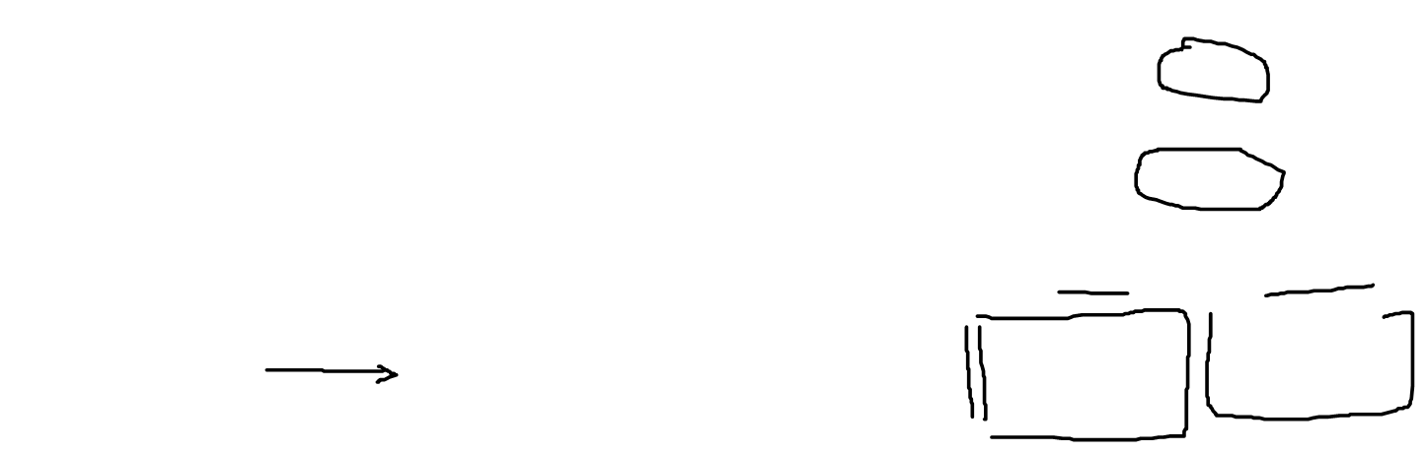
Decision tree

Slide 7

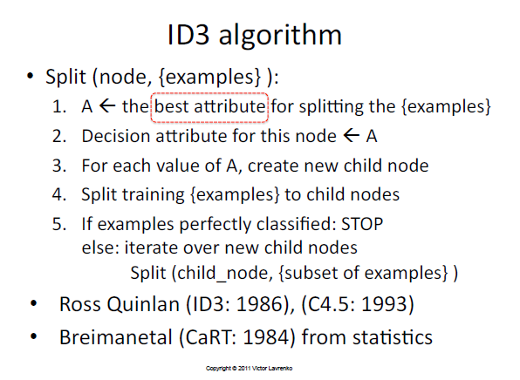
Decision tree

Slide 8

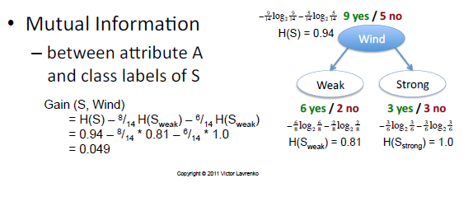

Decision tree

Slide 9

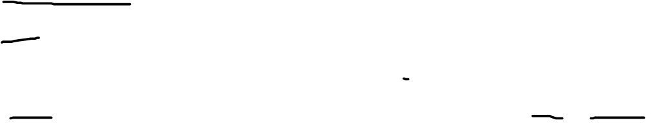
Data stream mining: decision tree
Non-additive methods: the example of decision trees
VFDT: Very Fast Decision Trees (Domingos & Hulten 2000)
X₁, X₂, …, X_{p}: discrete or continuous attributes
Y: discrete attribute to predict
Elements of the stream (x₁, x₂, …, x_{p}, y) are examples
G(X): measure to maximize to choose splits (ex. Gini, entropy, …)

Slide 10

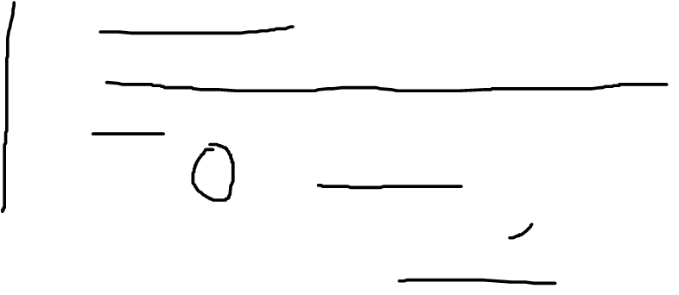
Data stream mining: decision tree
Hoeffding trees: not necessary to wait for all examples to choose a split
Algorithm
Maintain G(X_{j})
Wait for a minimum number of examples, n
Xj, Xk: the 2 variables with highest values of G
Split on X_{j} when G(X_{j}) - G(X_{k}) ≥ ε
Recursively apply the rule by pushing new examples in leaves of the tree
Notes:
Guarantees that chosen splits are the right ones
Quand une variable a été utilisée, elle est retirée des candidates dans les sous-arbres.
Quand une nouvelle feuille est créée, les statistiques sont remises à 0.
Refinements: poor attributes are detected, …

Slide 11

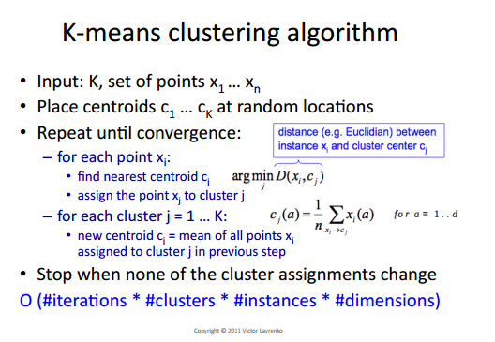
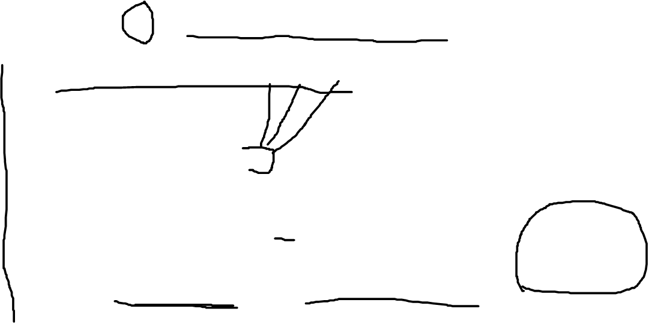

Slide 12

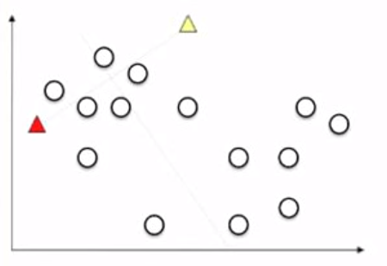
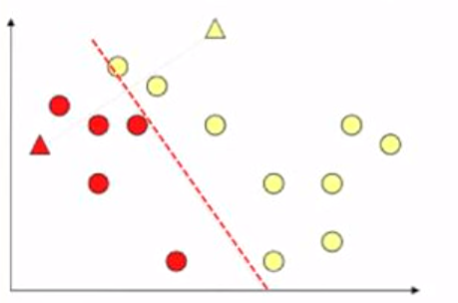
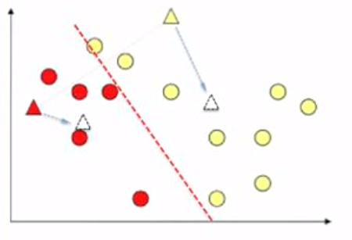
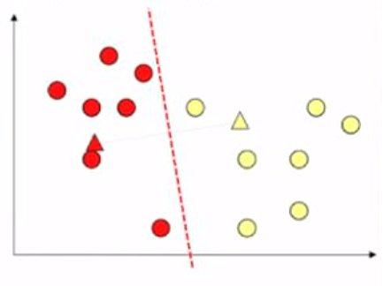
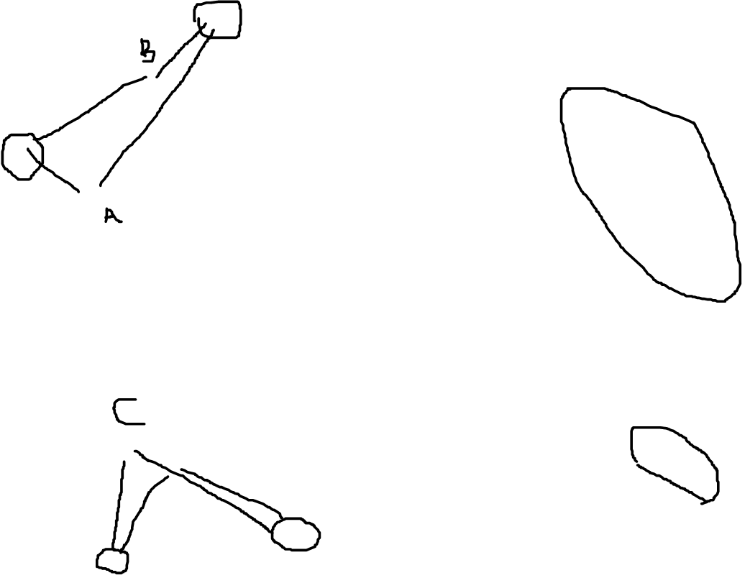

Slide 13

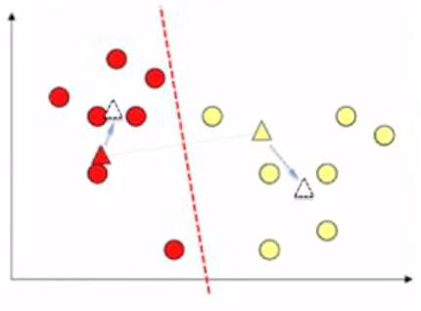
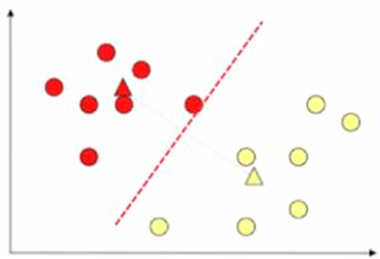
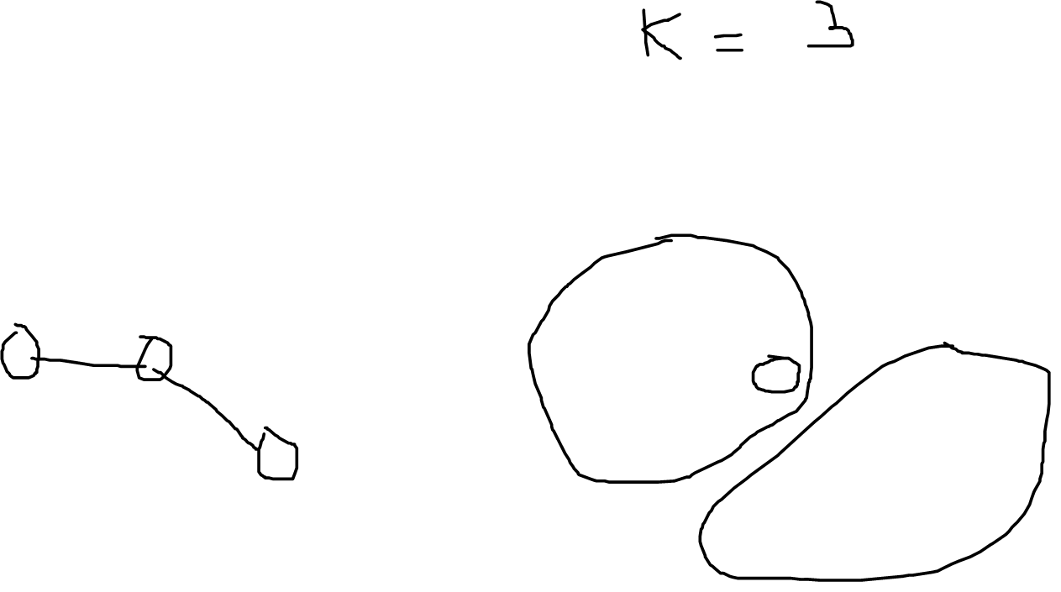
K means clustering

Slide 14

Data stream mining: clustering
Two distinct clustering problems
Maintain k centers of clusters (k-means)
Maintain k clusters with statistics on their contents (clustream)

Slide 15

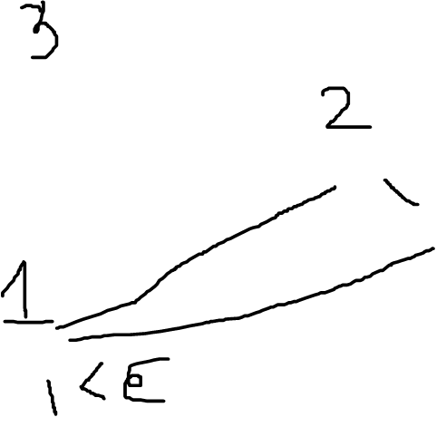
K-means for data stream

Slide 16

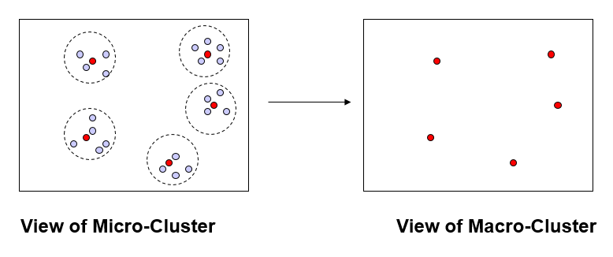
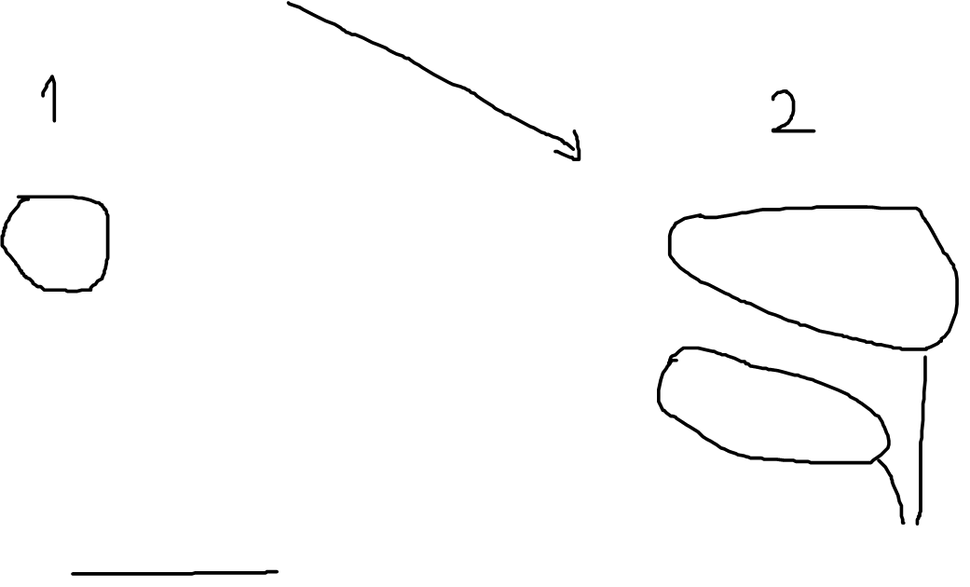
K-means for data stream

Slide 17

Data stream mining: clustering
Two distinct clustering problems
Maintain k centers of clusters (k-means)
Maintain k clusters with statistics on their contents (clustream)

Slide 18

Clustream
Clustream (Aggarwal et al. 2003)
Numerical variables
2 phases:
On-line phase: maintenance of a large number of ‘micro-clusters’ described by statistics of their contents
Off-line phase: use of micro-clusters to produce a final clustering
Mechanism to keep track of micro-clusters history

Slide 19

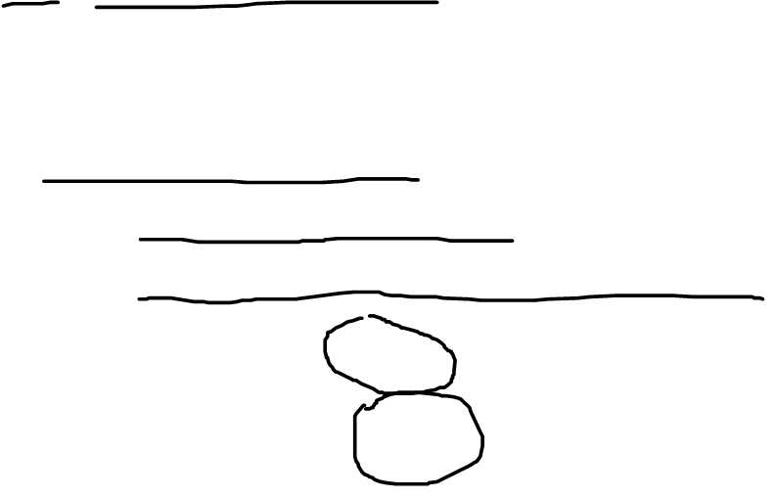
Clustream
Representation of micro-clusters
CVF: Cluster Feature Vector (BIRCH)
(n, CF1(T), CF2(T), CF1(X₁), CF2(X₂), …, CF1(X_{p}), CF2(X_{p}))
n: number of data points
CF1(T): sum of the time stamps T_{i1}…T_{in}
CF2(T): sum of the squares of the time stamps
Supports union/difference by addition/substraction
Incremental computation (elements are disgarded)

Slide 20

Thank You.

